Slide 1
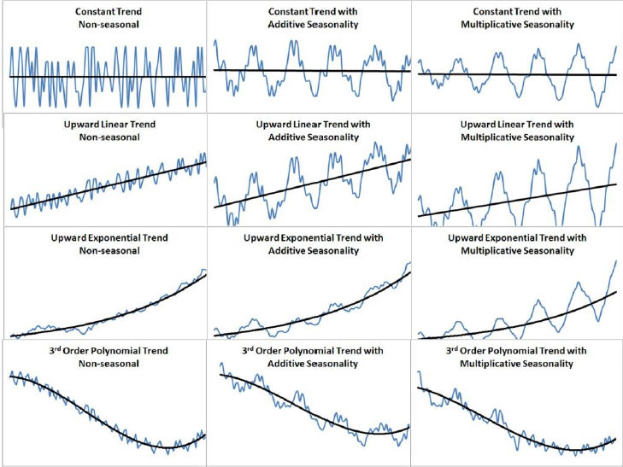
Introduction to Time Series

Slide 2
Type of Research Design
Observational Study
Cross sectional study – Cross-sectional surveys involve interviewing a fresh sample of people each time they are carried out. Some cross-sectional studies are repeated regularly and can include a large number of repeat questions (questions asked on each survey round). The defining feature of a cross-sectional study is that it can compare different population groups at a single point in time.
Longitudinal study - A longitudinal study is a prospective observational study that follows the same subjects repeatedly over a period of time. it is important that longitudinal studies collect the same information every time they visit their participants.
Correlational Study
Experimental Study

Slide 3
Time Series – Introduction….
Granger & Newbold described a time series as “… a sequence of observations ordered by a time parameter.”
Time series may be measured continuously or discretely. It finds its application to understand the pattern of data over time. The data could be a natural event like crop yield , rainfall , economic growth in relationship with unemployment, stock price movement etc.
Uses of Time Series:
To forecast future values of a series
Identification of transfer function – underlining the input – output model
To assess the impact of unusual events on the behaviour of time series
To examine the relationships among several time series.

Slide 4
Stochastic & Deterministic Processes
Time series are realizations of underlying data-generating processes over a time span occurring at a regular point of time. The underlying data generating process is not observed.
Time series have deterministic and stochastic components. If the process is stochastic , each data point is of the series is viewed as a sample mean of a probability distribution of an underlying population at each point of time. Each distribution has a mean and a variance.
The series that are not driven by stochastic processes may be driven by deterministic process. Such deterministic relationship could be driven mathematical formula which is “exact” in nature.

Slide 5
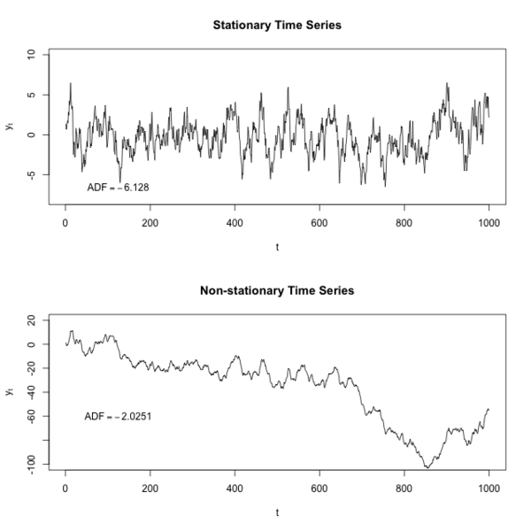
Characteristics of a Time Series.
Stationary series are characterized by a mean-reverting phenomena wherein the data generating processes converge towards a constant mean. The dispersion around the mean also remains constant.
There are different types of stationarity –
Weakly stationary – fixed mean and constant variance
Strictly Stationary - Fixed mean , constant variance and auto-covariance.
If a series a stationary then autocorrelation increases over time.
If the series is non-stationary autocorrelation diminishes gradually over time. Non stationary series are characterized by random walk , drift, trend or changing variance.

Slide 6

Characteristics of a Time Series – Various types of series – Visualising Time series Data in R
White Noise - A simple kind of generated series might be a collection of uncorrelated random variables, w(t), with mean 0 and finite variance σw^2 . A random normal variable is considered as “White Noise”
Auto-regression –
The above equation is an example of auto-regression of order 2, where w(t) is a white noise variable.
Random Walk with drift
Again , w(t) is white noise , delta is the drift variable, without delta , the series would have been a simple random walk.

Slide 7
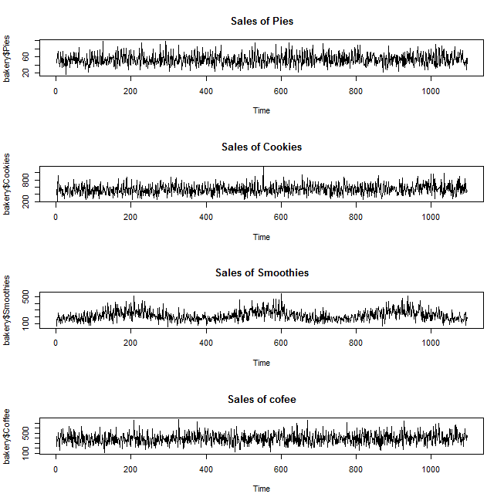

Slide 8
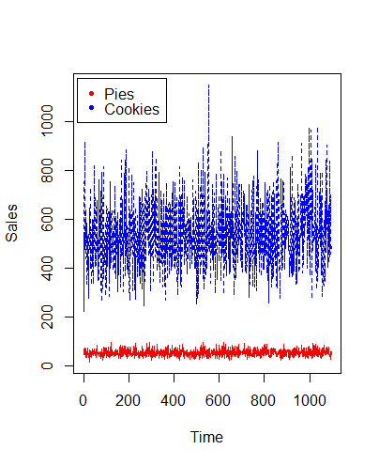
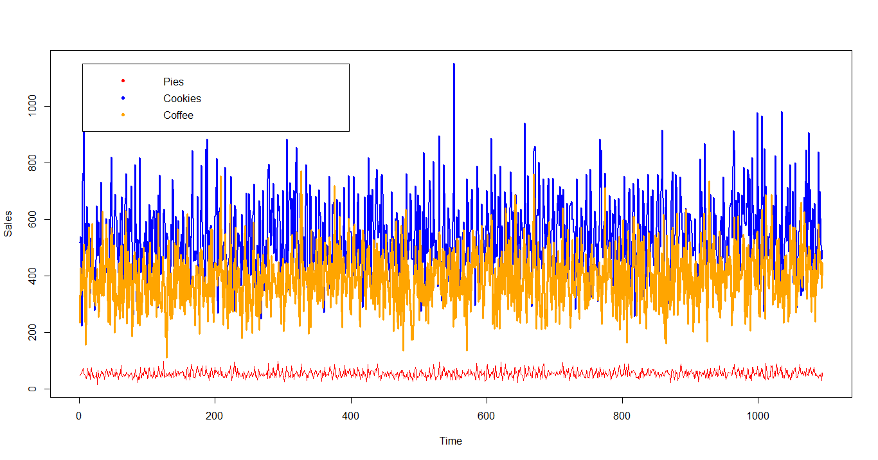
Plotting Time Series Data , The following diagram is the representation of Bakery Data,
The dataset Contains sales of 4 products over 3 years. Two functions in R could be used for this ts.plot() and plot.ts().

Slide 9
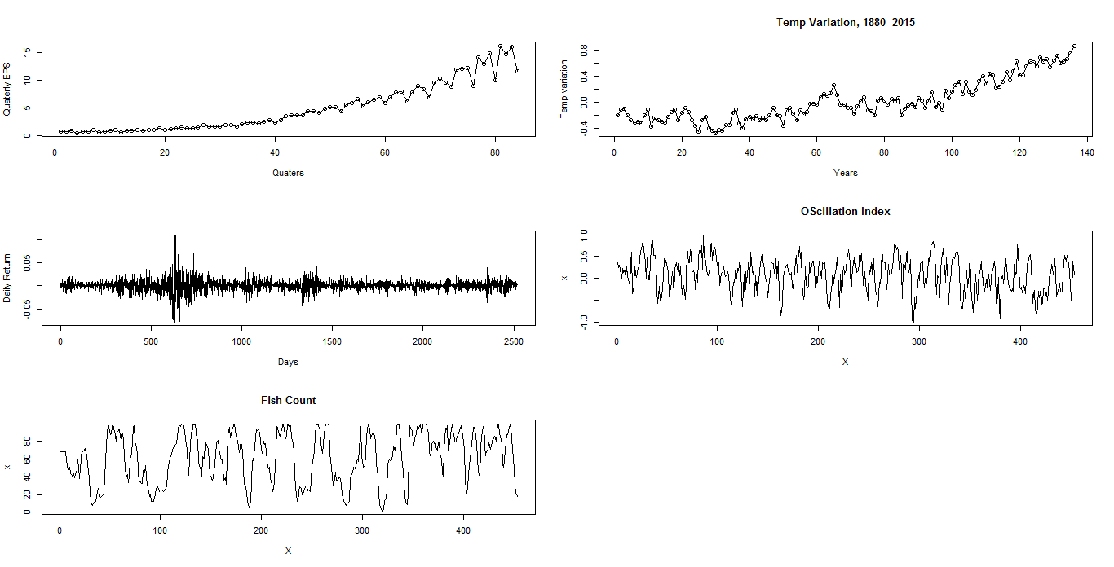
Plotting Time Series in R

Slide 10
Noise - Pattern
The various graphs we have seen varies in terms of degrees of smoothness. One possible explanation for this exhibited smoothness is the “supposition” that values in time points are “correlated “.
Noise : Time series generated from uncorrelated variables is used as a model for NOISE. But where mean of data points are “0” and they have a finite standard deviation then such time series is known as WHITE NOISE. wt ∼ wn(0, σ2).
Sometimes require the noise to be independent and identically distributed (iid) random variables with mean 0 and variance σ2w. . We distinguish this by writing wt ∼ iid(0, σ2) or by saying WHITE INDEPENDENT NOISE or IID NOISE like Gaussian White Noise. , where variables are independent normal random variables with mean “0” and σ2.

Slide 11
TREND & NOISE Pattern……

Slide 12
Signal in Noise
Many realistic models for generating time series assume underlying signal with some consistent periodic variation by adding a random noise . In the first Equation the second term is the random noise.
In addition a sinusoidal waveform can be written as the above equation. Where A is the “amplitude” , “ω” is the frequency of oscillation and “φ “is the phase shift.

Slide 13

Dependence Structure – Auto-covariance and Auto-regression in R
Auto – covariance:
For smooth curve the value of auto-correlation remains high even if the two points are distantly located. For choppy curves the value remains low.
Auto – correlation:
Auto-correlation gives indication about the linear predictability. Higher the correlation higher will be the accuracy.
Auto – regression :
Let us define a time series through the following - X(t) = X(t-1) - 0.9* X(t-2) + W(t)
This series depends upon previous two values at t and (t-2). The problems to generate such series is the initial values of not available, so x1 = w1, X2 = x1 + w2, but these values does not tally with the equation. So some initial values are removed. This leads to output underlining a pattern.

Slide 14
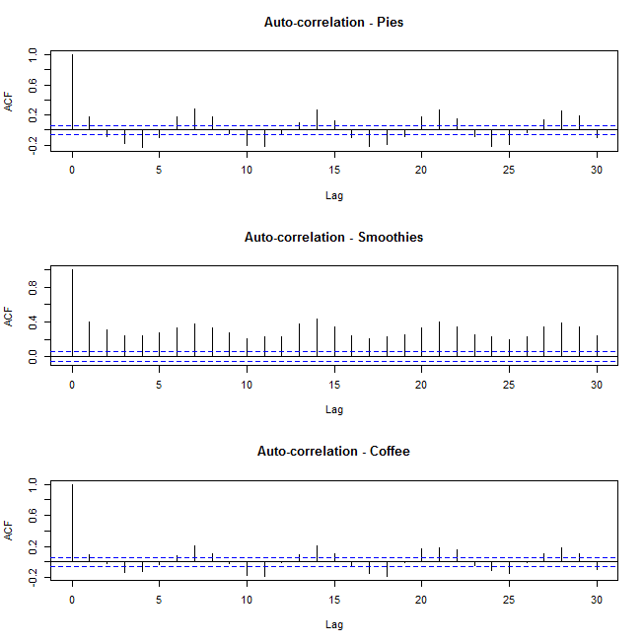

Slide 15
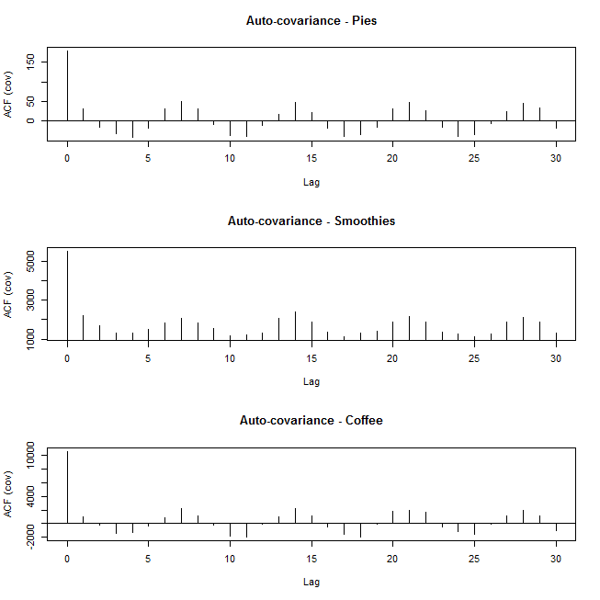

Slide 16
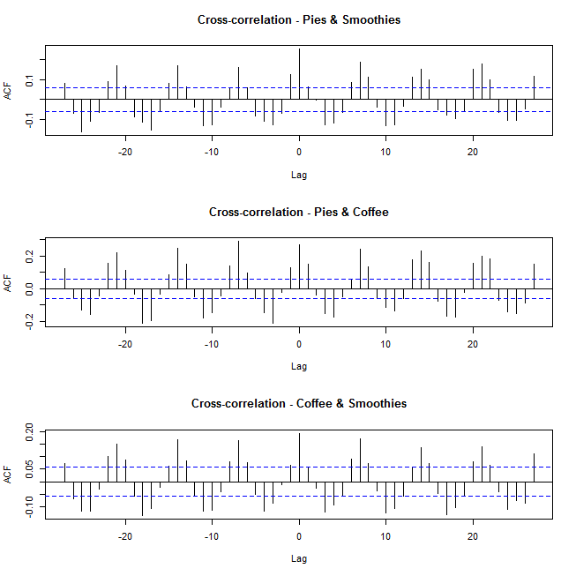

Cross- covariance:
Cross-correlation:
It reflect the relation between two series.

Slide 17
Random Walk with Drift
Following equation represents such situation
x(t) = alpha + x(t-1) + w(t)
w(t) , is the “white noise”. The constant “alpha” is called the drift . When “alpha” = 0 , this constitutes a “random walk”.
Its called a random walk , because the value of the time series at “t” completely depends upon the (t-1) and w(t).

Slide 18
Measures of Association
A times series can be described by the joint probability distribution function. The same can be captured by the following equation –
The above equation measures probability that the values of the series at different time points t1, t2, t3, ………, t4 is less than n-constants C1,C2,C3, ……, Cn.
Since the joint distribution has n-arguments , so the plotting the corresponding multivariate distribution function is “impossible”. Hence marginal distribution functions and marginal density functions .

Slide 19
Measures of Association
The marginal distribution functions and the marginal density functions are often informative for examining the marginal behaviour of a series.
Apart from the marginal distributions, following descriptive statistics are also very important -
Mean
Auto-covariance
Covariance
Autocorrelation
Partial Autocorrelation
Cross correlation
Marginal Distribution Functions
Marginal Density Function

Slide 20

The Autocovariance Function:
This is defined as follows -
The autocovariance function measures linear dependence between two points on the same series observed at different times.
Smooth series exhibit high autocovariance even when the two point viz. “t”and “s” are very far.
Choppy series have lesser autocovariance, which is close to 0.
Autocovariance of a White Noise Series is as follows –

Slide 21
Short term Forecasting – Moving Average (in R)
Moving Average – the cumulative effect of the moving average gives more weight to the central observations rather than to those at the end of the series.
Simple Moving Average
Weighted Moving Average
Centered Moving Average - many series have even no of observations such as 12 months. A T period moving average should really be centered at the time period (T+1)/2 and this centering is known as correction of lag.
Double Moving Average - it is used for additional smoothening of a simple moving average. First a simple moving average is computed and then a second moving average is computed from the first moving average.
The double moving averages permits calculation of intercept and trend coefficient.

Slide 22



Mean of Moving Average :
Mean of a moving average of a white noise series is zero, since a white noise series fluctuates around mean.
Mean of a Random walk
Mean function of Signal plus Noise
The cosine function is the signal and
the error term is white noise one.

Slide 23
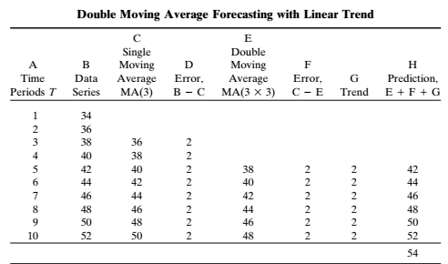
Double Moving Average
The intercept is simple the two times the single moving average minus the double moving average .
The trend coefficient is the average difference between the single moving average and the double moving average .
This is computed by subtracting the DMA from MA and dividing by (T-1).
This process is called moving average with a linear trend.

Slide 24

Exponential Smoothening
Exponential smoothening is a method conceived by Robert Macaulay in 1931 and developed by Robert G Brown during World War – II.
Like weighted average, exponential smoothening also uses wighted average of past data. It is based on the philosophy that the effect of the recent data is going to fade away over a period of time. Hence , the older is the data have lesser is the influence on future pattern.
The proportion of the latest observations is considered for forecasting the next period moving average is known as “smoothening constant”. The value of the ranges from “0” to “1”. This relationship is captured by the following equation –

Slide 25

Exponential smoothening Contd..
In the same view , the same equation can be used for forecasting in the following manner –
Where , is the forecasted value for period (t+1) and is the
last observation in period t.
One may note that the difference between and is the error. The equation may ne rewritten as follows –
+ ( - )*
This alpha is known as the memory of the process.

Slide 26
Holts Exponential Method
Normal exponential method fails to accommodate trend or non-stationary properties of a dataset. C. C Holt developed a model that accommodates a trend in the series. The final model has a mean and a slope coefficient along with an error term as indicated bellow –

Slide 27
Decomposition Methods
When early economists sought to understand the nature of a business cycle, they began studying series in search of calendar effects (prior monthly and trading day adjustments), trends, cycles, seasonal, and irregular components. These components could be added or multiplied together to constitute the time series.
The decomposition could be represented by
Y = P X D X T X S X C X I ----- multiplicative decomposition
Y = P + D + T + S + C + I ------ additive decomposition
P -> prior monthly adjustment
D -> trading day adjustment
T -> Trend ; S -> Seasonality ; I -> irregularity

Slide 28
Decomposition Methods Contd..
Calendar Effects -> this comprises of monthly and daily adjustments
Trend -> it’s a long-run characteristics , it may stochastic, random , deterministic.
Seasonal components are distinguishable patterns of regular annual variations in a series.
Cycles -> these are repetitive long range swings below and above some equilibrium values . They have upswings , peak, downswings and troughs . They are interest of study for predicting of the peak and troughs and the duration of up and down swings.
Trends -> suitable regression methods can be used to underline the trend (linear or non-linear)

Slide 29
Trend - For non-linear relationship appropriate transformation may be used to linearise the series. (Box-cox ) transformation or Log transformation. But if the trend is stochastic then one way to detrend the series is to take “difference transformation”.
Though seasonality can be tracked by either “additive” or “multiplicative” methods. , but it is the latter one which is more frequently applied.
Apart from these methods U.S Burea of Census developed an computer intensive model for seasonal adjustment (Julius Shishkin, Allan Yound and John Musgrave) , this method know as X-11. This methods decomposes a series into prior monthly, trading day, cyclical, seasonal and irregular variations.
Prior monthly factors are calender adjustments made for the months in which the series is under consideration.

